Slide 1
Choosing the right Deep Learning Framework: A Deep Learning Approach
Nick Acosta
Developer Advocate

Slide 2
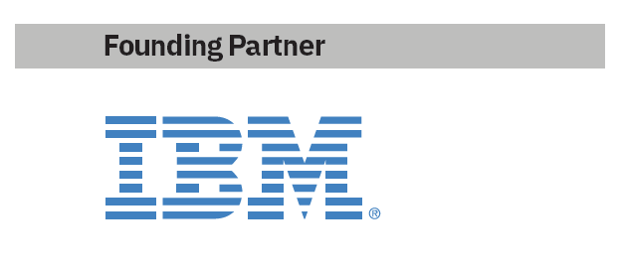






Call for Code 2019 Developer Challenge
How to get involved: www.developer.ibm.com/callforcode
View this year’s finalists: https://developer.ibm.com/callforcode/projects/
Developers… answer the call
Part of Code and Response™, this annual global developer challenge Call for Code, asks developers to create sustainable software solutions to prepare for, respond to and recover from natural disasters. The winning team receives:
A $200K cash prize
Open Source Support from The Linux Foundation
Meetings with mentors and potential investors
Solution implementation support through Code and Response™
www.developer.ibm.com/callforcall
Call for Code
challenge opens
March 25
Project Owl
Implementation
April
Cause Flash
(UN World Health Day)
April 7
Wildfire Community Preparedness Day
(+42 school event)
May 4
National Hurricane Preparedness Week
May 10
Cause Flash
(World Environment Day)
June 5
World Humanitarian Day
Aug 19
Award Event
October 13 NYC

Slide 3
Which Deep Learning Framework should I be using for neural network development?

Slide 4
Deep Learning Frameworks Advice
Content usually falls into three camps

Slide 5
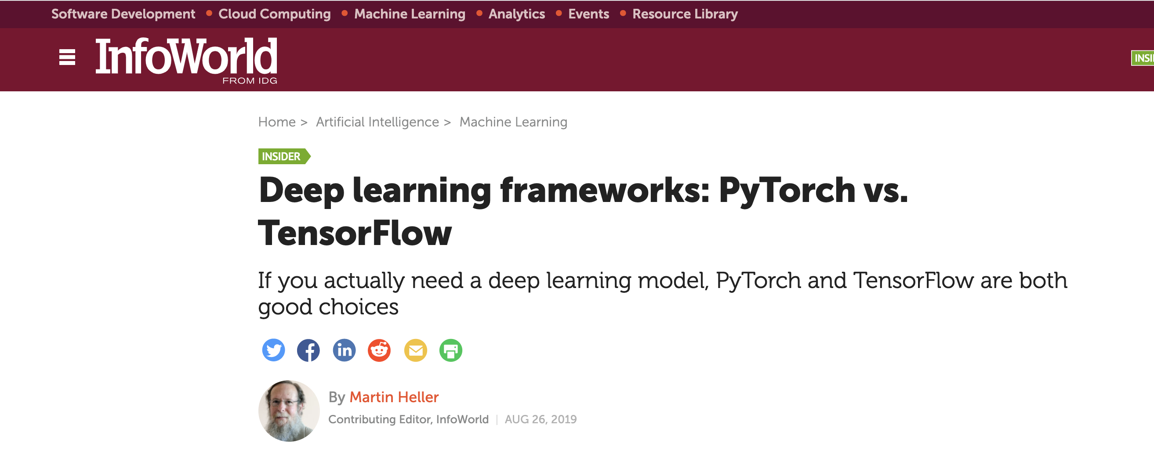
Deep Learning Frameworks Advice
Content usually falls into three camps
historical overview

Slide 6
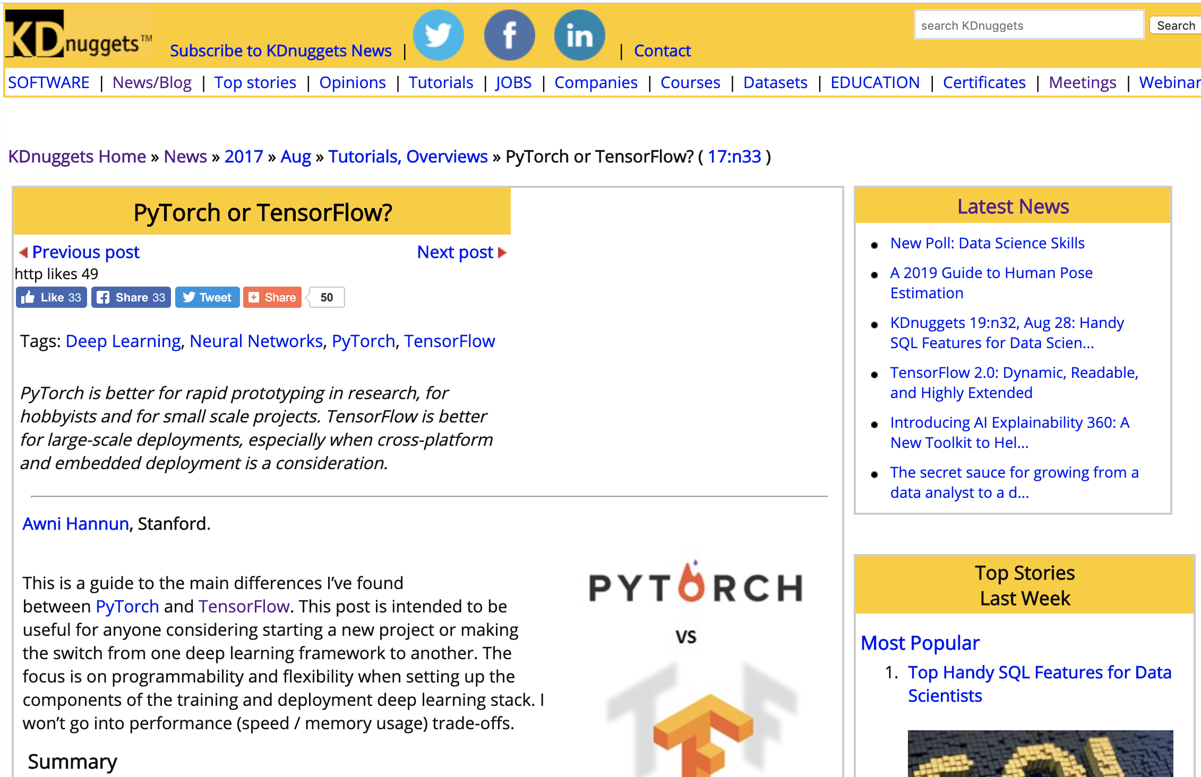
Deep Learning Frameworks Advice
Content usually falls into three camps
historical overview
explanation of differences

Slide 7
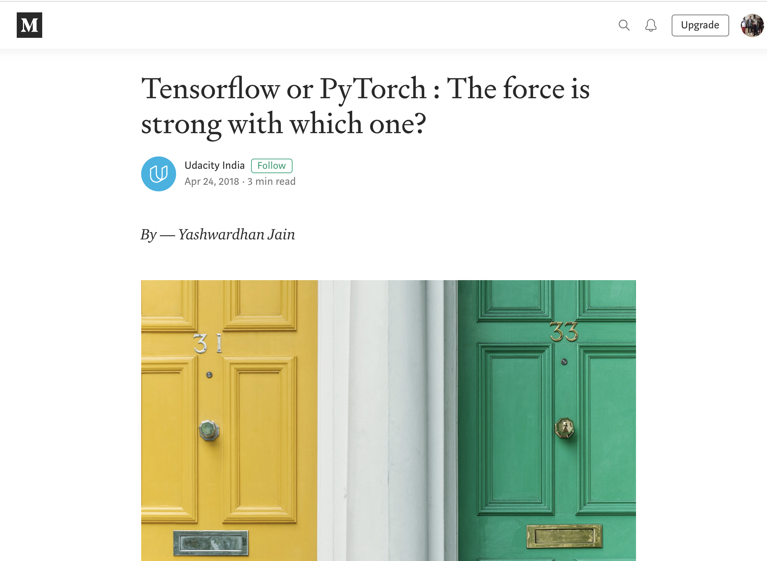
Deep Learning Frameworks Advice
Content usually falls into three camps
historical overview
explanation of differences
advisory of preference

Slide 8
Deep Learning Frameworks Advice
Content usually falls into three camps
historical overview
explanation of differences
advisory of preference
Some are combination of three, but most have an advisory voice

Slide 9
Deep Learning Frameworks Advice
Content usually falls into three camps
historical overview
explanation of differences
advisory of preference
Some are combination of three, but most have an advisory voice
prone to
subjectivity
anecdotal evidence
current state of deep learning frameworks

Slide 10
Start with the framework chosen for you via Deep Learning.

Slide 11
Agenda
Part One - Introduction 01
Call for Code 02
"Deep Learning Frameworks Advice" 04
Agenda 11
Part Two - Deep Learning Frameworks 12
Deep Learning Frameworks 24
TensorFlow
PyTorch
Part Three - Data 27
Data Source 28
Preparation for Deep Learning 31
Part Four - Models 37
Overview
Results
Deep Learning as a Service
Part Six - Conclusion 39
Resources 09

Slide 12
Deep Learning Frameworks

Slide 13
Deep Learning Frameworks
Allow for easy construction of neural networks

Slide 14
Deep Learning Frameworks
Allow for easy construction of neural networks
Abstract away lowest level detail
Standardize commonly used neural network concepts, from components to models
Provide tooling for deployment on various hardware configurations, including GPUs

Slide 15
TensorFlow
From Google via Google Brain
Late 2015
Build for distributed computing
Tensor - default data structure
n-dimensional array
Flow - execution via computational graph
C++ (CUDA) backend
mixed frontend

Slide 16
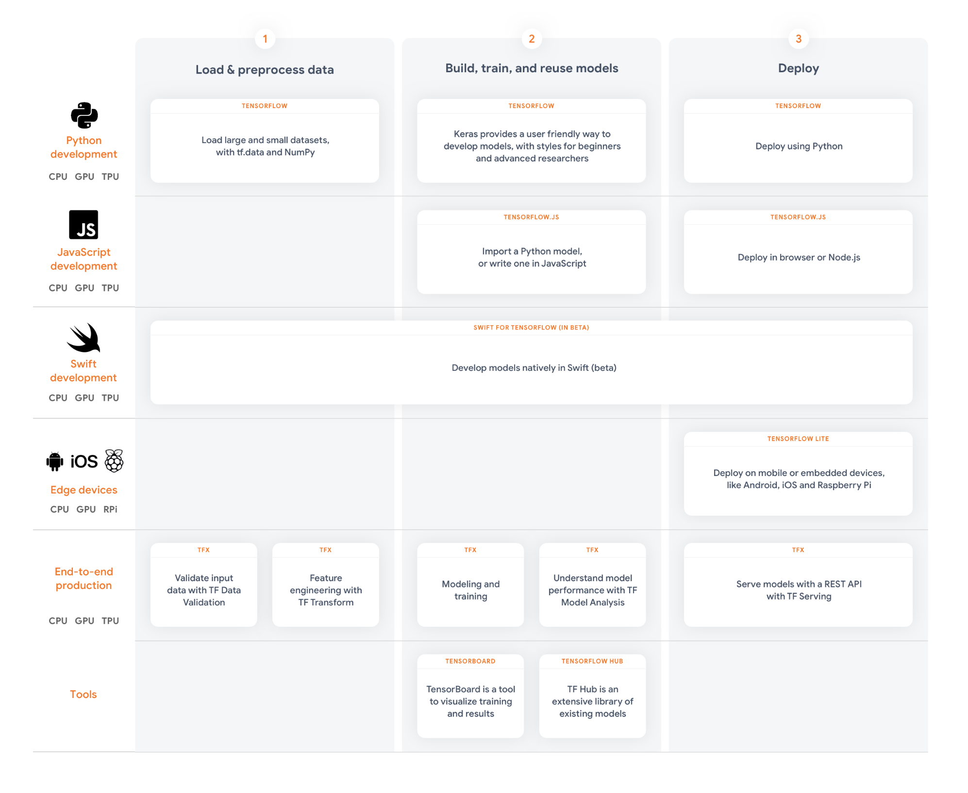
TensorFlow
From Google via Google Brain
Late 2015
Build for distributed computing
Tensor - default data structure
n-dimensional array
Flow - execution via computational graph
C++ (CUDA) backend
mixed frontend

Slide 17
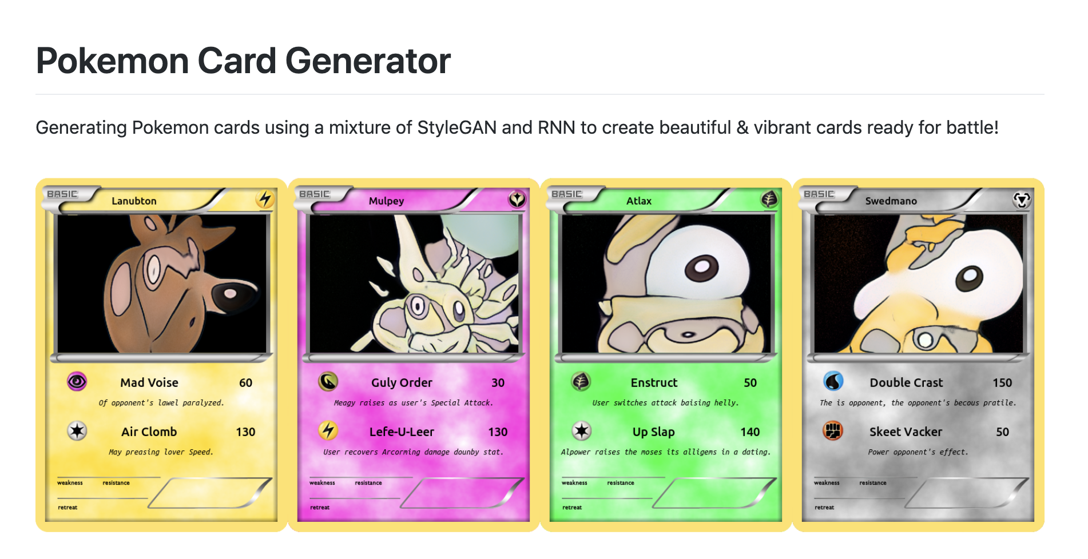
TensorFlow Case Study

Slide 18
PyTorch
From Facebook via Torch (and Caffe2)
Late 2016
Build for research in deep learning
Tensor - default data structure
n-dimensional array
Torch – scientific computing and machine learning library
Known as generally dynamic and pythonic

Slide 19

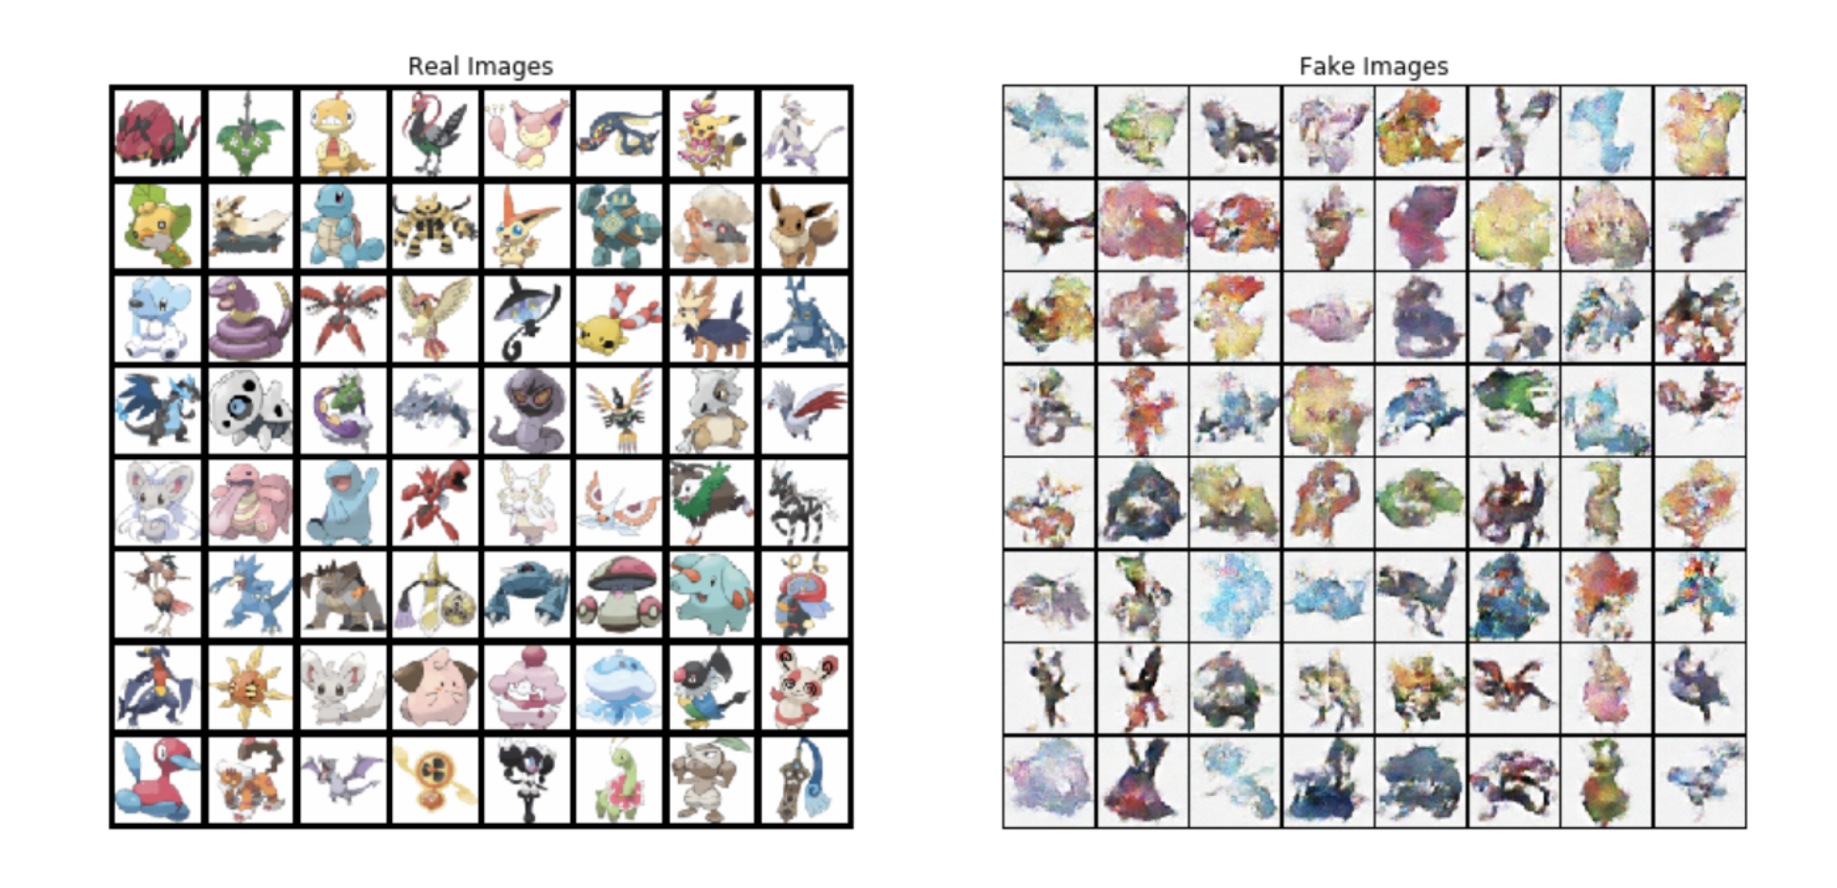
PyTorch Case Study

Slide 20
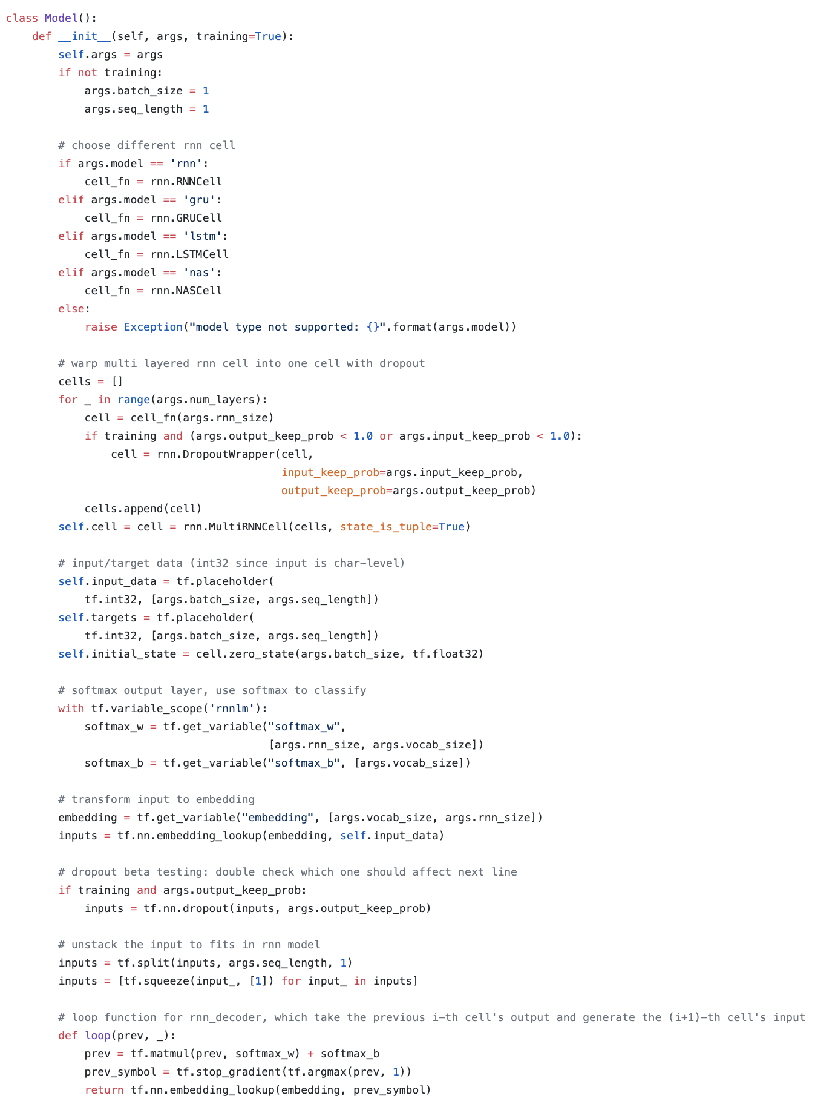
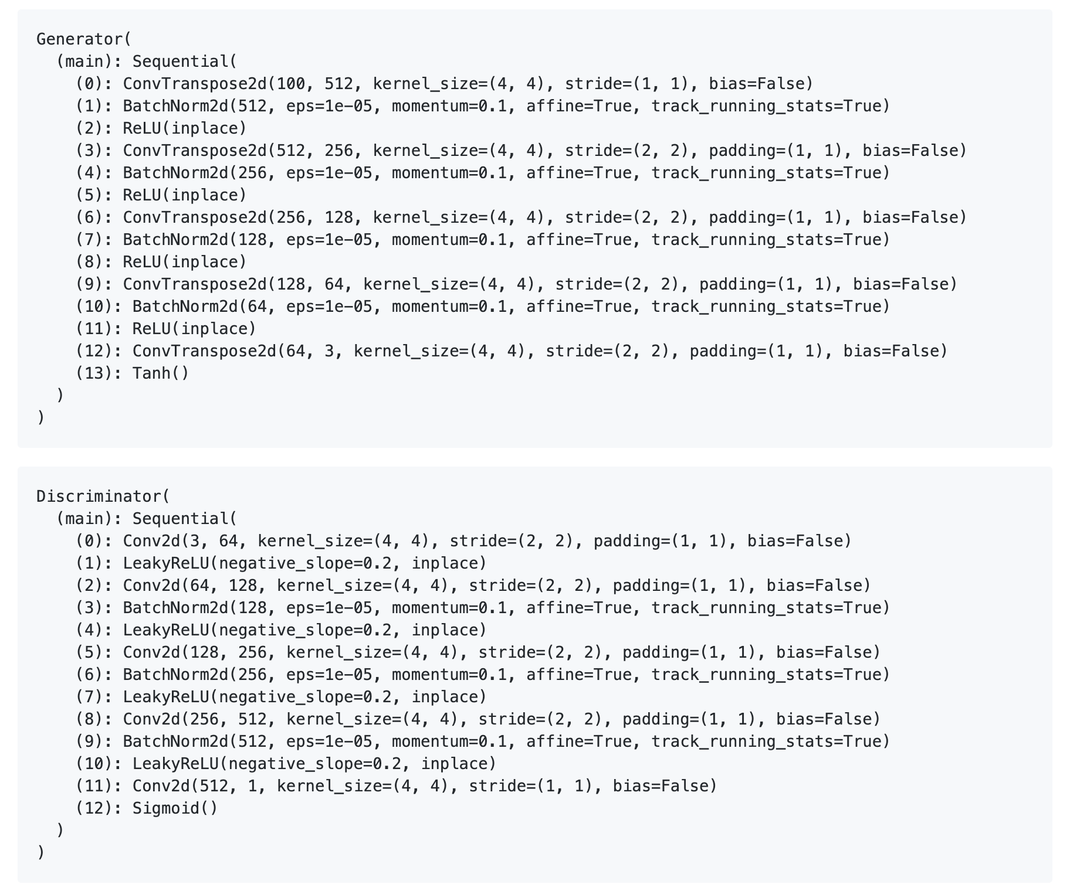
Differences

Slide 21
Data

Slide 22
Classes

Slide 23
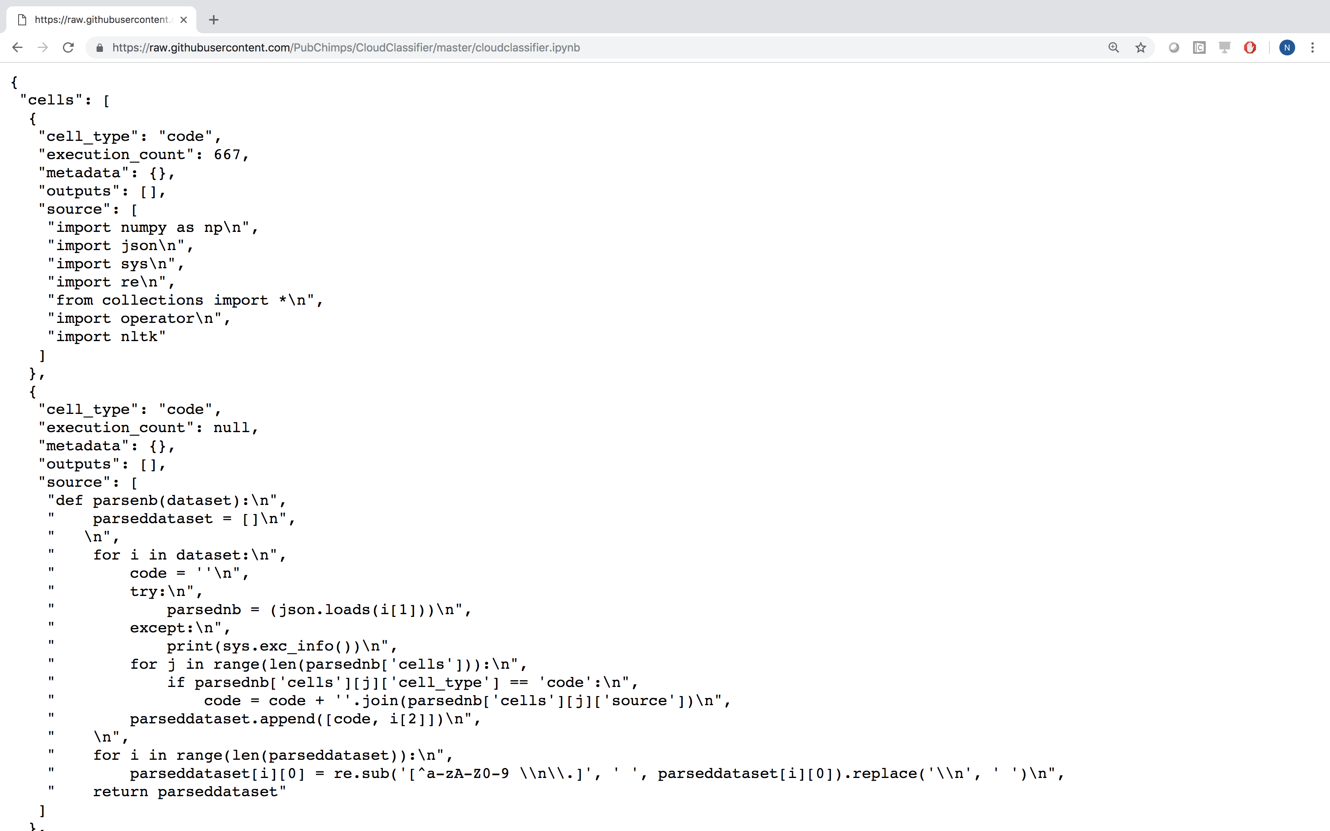
PyGitHub

Slide 24
PyGitHub
[['import plotly offline as py from plotly graph objs import Data Contour py init notebook mode connected True data Data Contour 10 10 625 12 15 625 12 15 625 20 625 25 125 11 25 15 625 125 125 12 625 25 125 25 10 625 625 625 10 py iplot data show link False’], 'azure']
[['import numpy as np import pandas as pd Importar librer de plots sicos import matplotlib pyplot as pltX1 np random normal 100 X2 np random normal 100 plt plot X1 plt plot X2 plt xlabel Tiempo plt ylabel Retorno plt legend X1 X2 X1'], 'watson']
[['import numpy as np import matplotlib pylab as plt Convert x1 x2 x3 x4 to bool bool bool Convert bool bool to def step function return as type np int np arange step function plt plot plt ylim plt show Convert x1 x2 x3 x4 to All results are between and def sigmoid return np exp np arange sigmoid plt plot plt ylim plt show def relu return np maximum np arange relu plt plot plt ylim plt show def identify function return xdef softmax np max exp np exp sum exp np sum exp exp sum exp return softmax def softmax if ndim np max axis axis np exp np sum np exp axis return np max return np exp np sum np exp'],'aws']

Slide 25
Stats
set 1 set 2 set 3
split 70/30 tensorflow 57/43 tensorflow
repos - 2270
notebooks 5351 11475
total words 3,105,210 6,577,661
unique words 35,214 55,023
size 544 MB 1.06 GB

Slide 26
Data Preparation
Bag of Words (One-Hot Encoding)
Each element in dataset becomes feature vector
representation of every word in dataset
Full Representation of data
Extremely sparse

Slide 27
Data Preparation
Bag of Words (One-Hot Encoding)
Each element in dataset becomes feature vector
representation of every word in dataset
Full Representation of data
Extremely sparse
Text Embedding
Translate dataset to a lower dimensional, more dense space
Double number of hyperparameters
Common, predefined text embedding (define semantics)
Trainable within neural network

Slide 28
Models

Slide 29
4 Chosen

Slide 30
Results

Slide 31
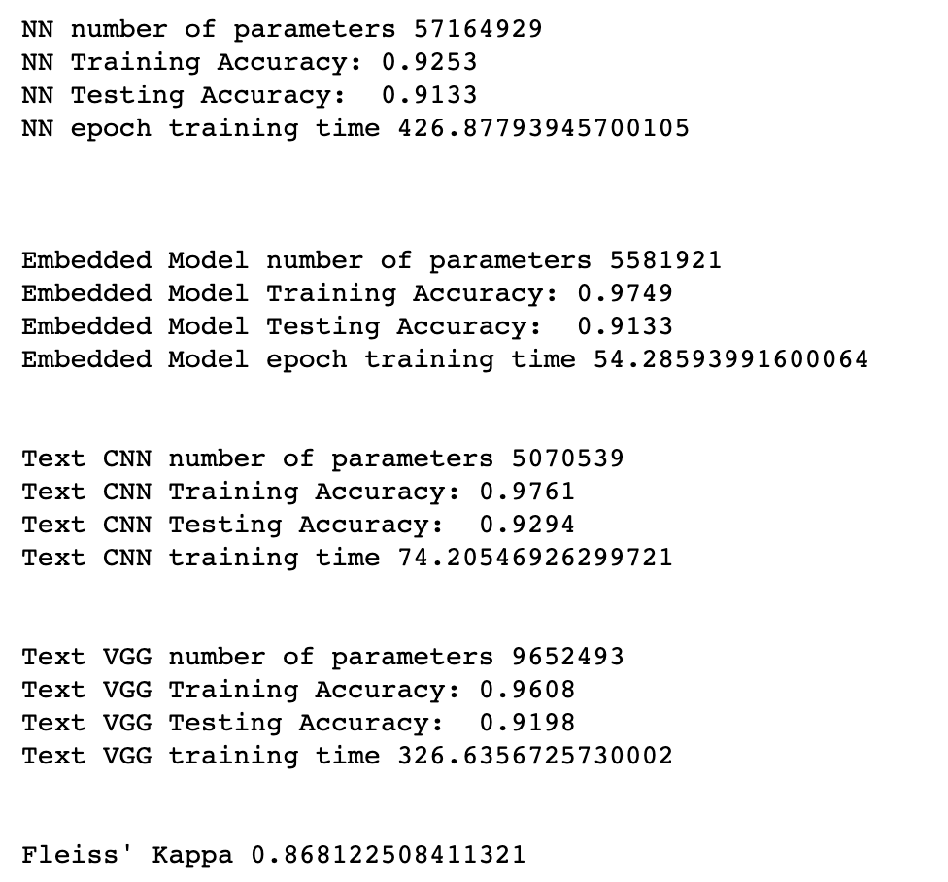
Results - Accuracy

Slide 32
Results - Accuracy

Slide 33
Results - Accuracy

Slide 34
Results - Accuracy

Slide 35
Results - Accuracy

Slide 36
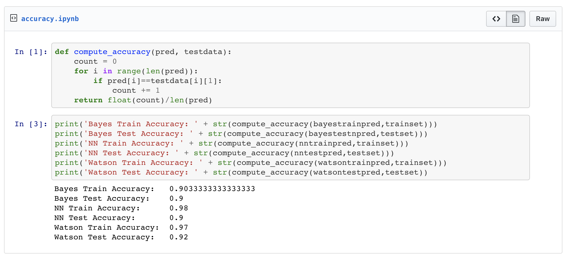
Results - Fleiss’ Kappa Coefficient

Slide 37
The End

Slide 38
Resources
http://dlclassifier.mybluemix.net/
https://github.com/PubChimps/dlclassifier
https://www.ibm.com/community/datascience/

Slide 39
Thank You
Nick Acosta
Developer Advocate
—
nacosta@us.ibm.com

